Slide 1

Chapter 2:
Data Visualization
Notes:
1

Slide 2
Objective
Understand the concept and importance of data visualization in the context of data mining.
Explore the goals and benefits of using data visualization techniques.
Learn various techniques for numerical data, including line charts, bar charts, scatter plots, etc.
Understand the techniques specific to non-numerical data, such as pie charts, word clouds, network graphs, etc.
Gain insights into the visualization of dashboards, including the components, design principles, and interactive features.
2

Slide 3
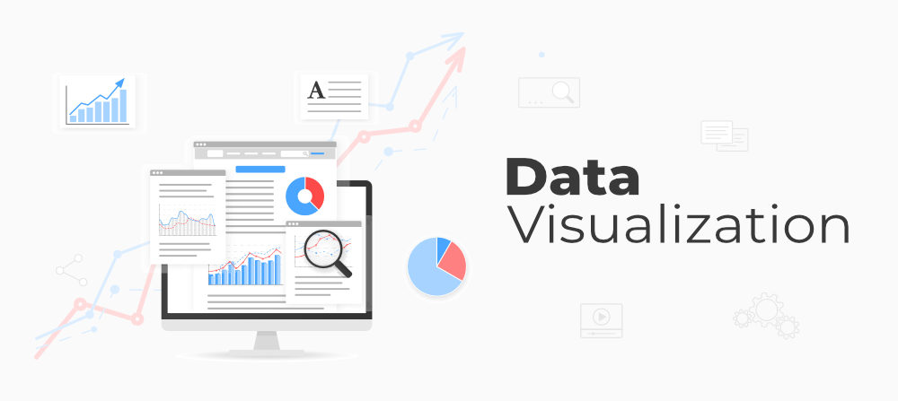
Introduction to Data Visualization
[Credit: https://www.geeksforgeeks.org/ ]

Slide 4
Introduction to Data Visualization
Definition of data visualization
Data visualization is the graphical representation of data and information using visual elements such as charts, graphs, and maps.
A powerful tool that allows to explore, analyze, and communicate insights from complex datasets in a visual and intuitive manner.
In the field of data mining, data visualization plays a crucial role in uncovering patterns, trends, and relationships that might otherwise be difficult to identify.
4

Slide 5
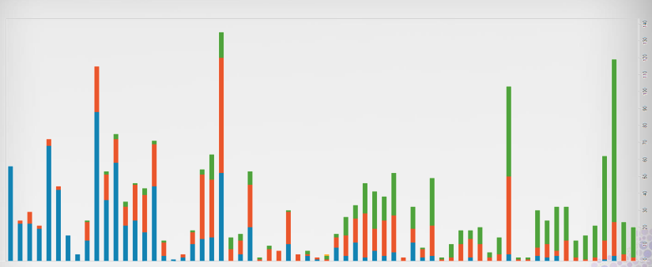
Introduction to Data Visualization
Data visualization example
[Credit: John C.Hart _ CS Department _ University of Illinois]
5

Slide 6
Introduction to Data Visualization
Importance of data visualization in data mining - 1
Data visualization helps in understanding the underlying patterns and structures within data. It allows to identify correlations, clusters, outliers, and other valuable insights that can drive informed decision-making.
It facilitates effective communication of findings to a wide range of stakeholders, including technical and non-technical audiences. Visual representations can convey complex information more easily than raw data or textual descriptions.
6

Slide 7
Introduction to Data Visualization
Importance of data visualization in data mining - 2
By representing data visually, we can quickly detect anomalies, spot trends, and make data-driven predictions. This enables us to gain actionable insights and extract value from large and complex datasets.
Data visualization enhances the exploratory data analysis process, enabling data miners to interactively manipulate visualizations, filter data, and discover hidden patterns or outliers in real-time.
7

Slide 8
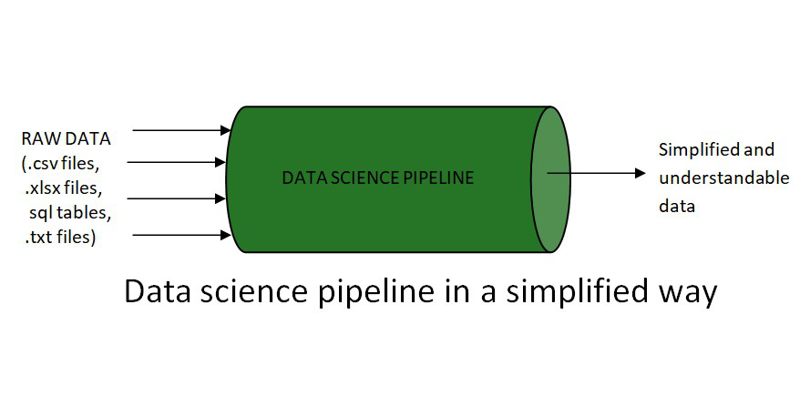
Introduction to Data Visualization
Goals and Benefits of Data Visualization - 1
Simplify Complexity:
Visualizations simplify complex datasets by presenting information in a concise and organized manner. They condense vast amounts of data into visual summaries that are easier to understand and interpret.
[Credit: https://www.geeksforgeeks.org/ ]
8

Slide 9
Introduction to Data Visualization
Goals and Benefits of Data Visualization - 2
Identify Patterns and Trends:
Visual representations help us identify patterns, trends, and relationships between variables that may not be apparent in raw data. By spotting these patterns, we can make better predictions and derive actionable insights.
9

Slide 10
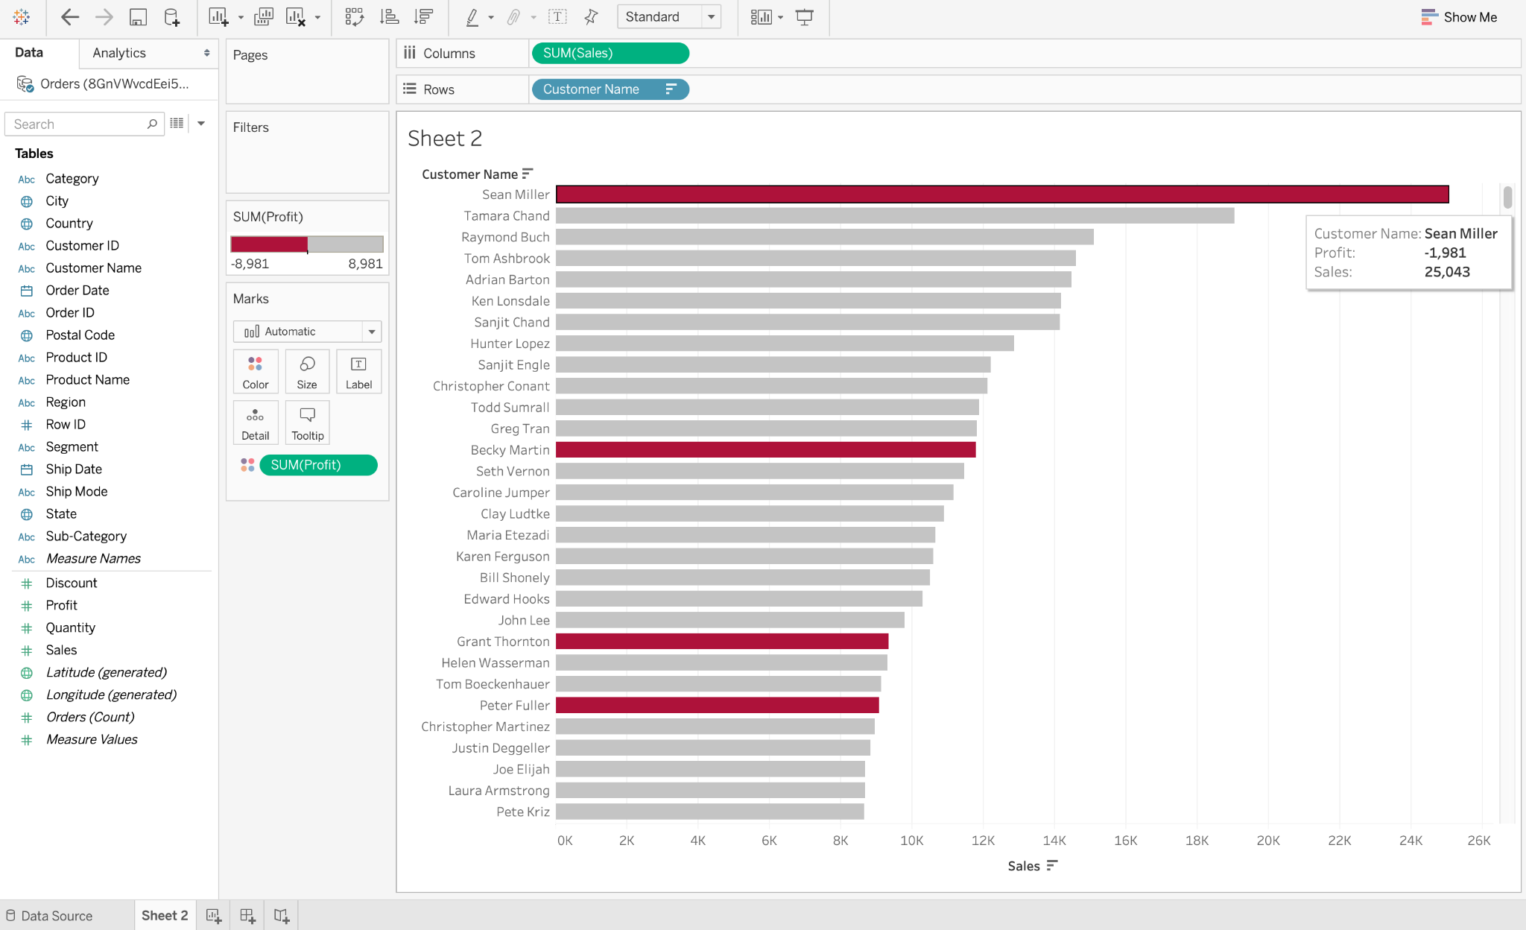
Introduction to Data Visualization
Example of Data Visualization Discovers the Trends in Data
[Credit: https://www.geeksforgeeks.org/ ]

Slide 11
Introduction to Data Visualization
Goals and Benefits of Data Visualization - 3
Aid Decision-Making:
Data visualization enables data miners to make more informed decisions by providing a clear understanding of the data. Visual representations assist in identifying outliers, making comparisons, and evaluating different scenarios.
11

Slide 12
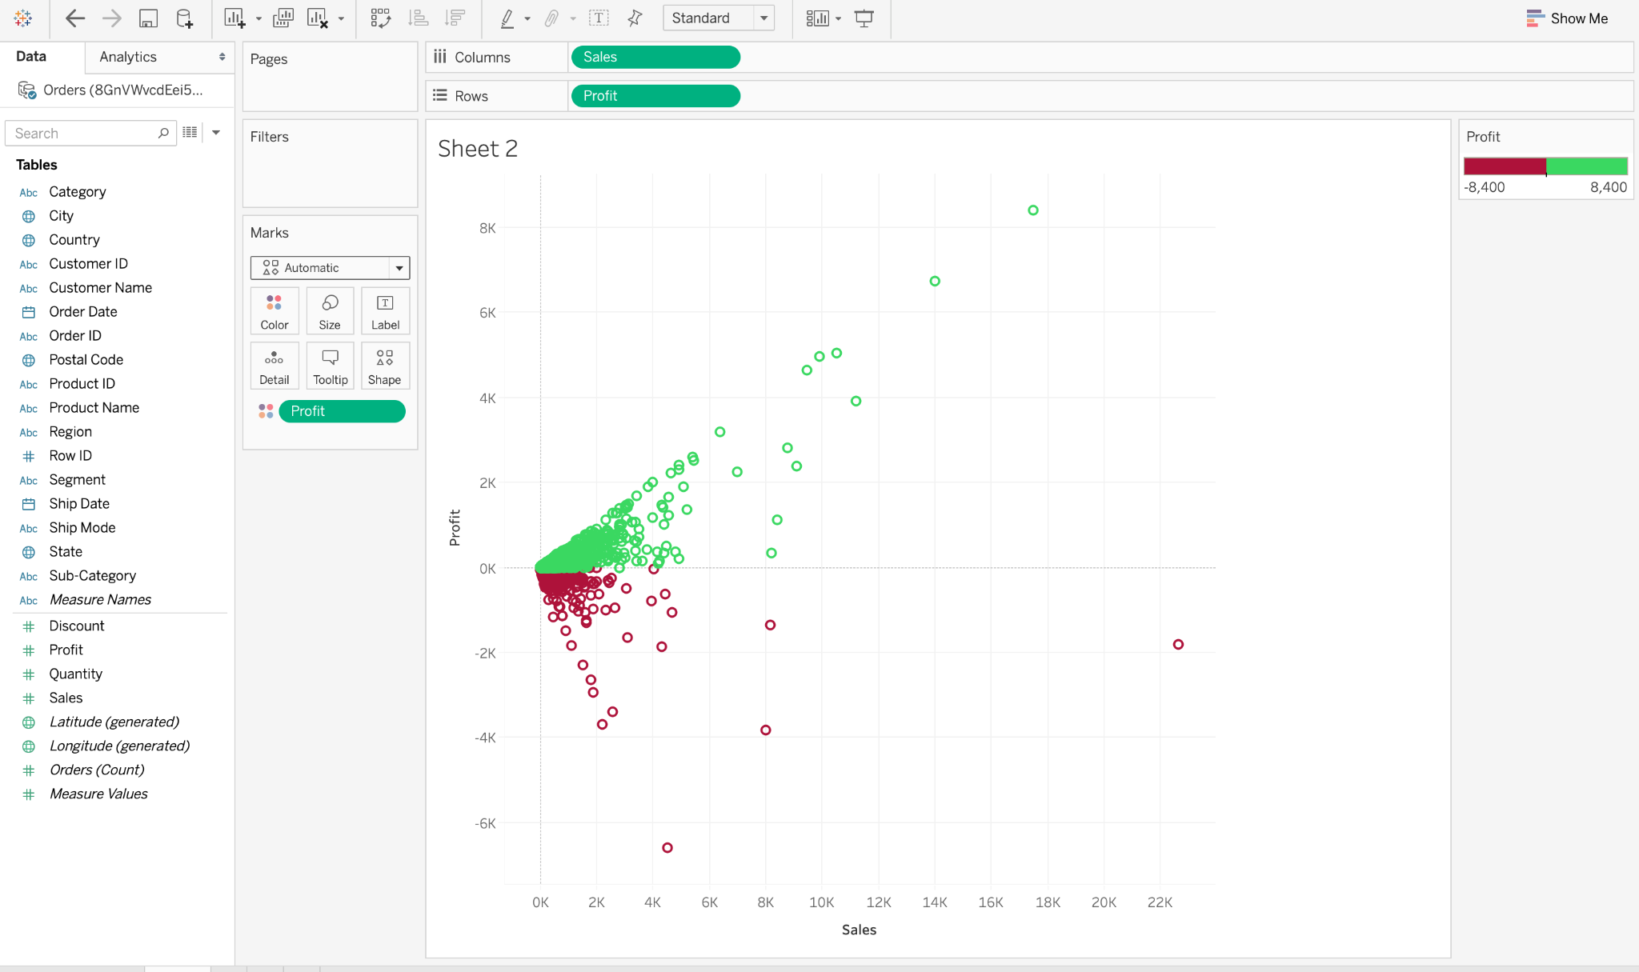
Introduction to Data Visualization
[Credit: https://www.geeksforgeeks.org/ ]

Slide 13
Introduction to Data Visualization
Goals and Benefits of Data Visualization - 4
Enhance Data Exploration:
Visualizations allow for interactive exploration of data, enabling users to drill down into specific details, filter data, and explore different perspectives. This interactivity promotes a deeper understanding of the underlying data.
13

Slide 14
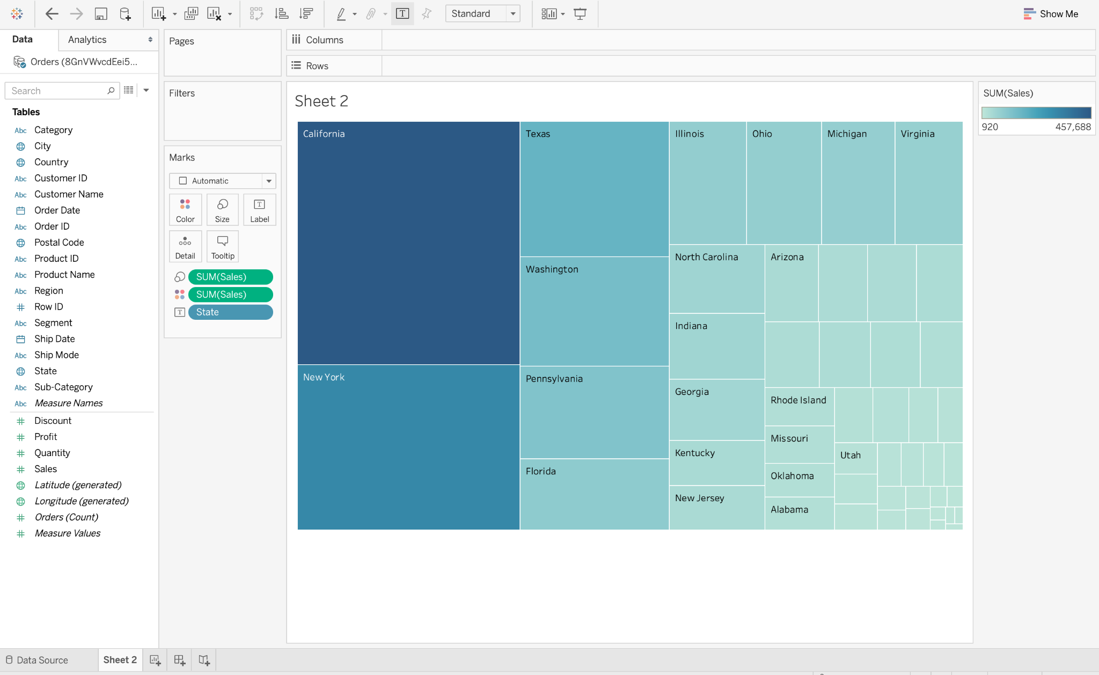
Introduction to Data Visualization
Data Visualization Puts the Data into the Correct Context
[Credit: https://www.geeksforgeeks.org/ ]

Slide 15
Introduction to Data Visualization
Goals and Benefits of Data Visualization - 5
Improve Communication:
Visualizations are an effective means of communicating findings and insights to stakeholders. They facilitate the sharing of information in a visually appealing and easy-to-understand format, enabling better collaboration and decision-making.
15

Slide 16
Summary
Introduction to Data Visualization
Data visualization: Graphical data representation.
Importance in data mining: Clarity, insights, decision support.
Goals: Simplify, discover, communicate.
Benefits: Understanding, speed, communication.
16

